Slide 1


Customizing and organizing GraphQL operations

Slide 2
Customizing fields with arguments returned by a list field
Renaming fields with aliases
Customizing responses with directives
GraphQL fragments
Table of Contents

Slide 3
Customizing & organizing GraphQL operations
This lesson covers
Using arguments to customize what a request field returns
Customizing response property names with aliases
Describing runtime executions with directives
Reducing duplicated text with fragments
Composing queries and separating data requirement responsibilities
Notes:
In any nontrivial application, you have to do many things beyond asking the server a direct, simple, single-value question. Data fetching is usually coupled with variables and meta-questions about the structure of the response. You often need to modify the data returned by the server to make it suitable for your application. Sometimes you have to remove parts of the data or go back to the server and ask for other parts that are required based on conditions in your application. Sometimes you need a way to organize big requests and categorize them to know which part of your application is responsible for each part of your requests. Luckily, the GraphQL language offers many built-in features you can use to do all of this and much more. These customizing and organizing features are what this lesson is all about.

Slide 4
Customizing fields with arguments
The fields in a GraphQL operation are similar to functions. They map input to output.
A function input is received as a list of argument values.
Just like functions, we can pass any GraphQL field a list of argument values.
A GraphQL schema on the backend can access these values and use them to customize the response it returns for that field.
Notes:
Let’s look at use cases for these field arguments and some examples used by the GitHub GraphQL API (az.dev/github-api).

Slide 5
Identifying a single record to return
Example query that asks for information about the user whose email address is jane@doe.name.
query UserInfo {
user(email: "jane@doe.name") {
firstName
lastName
username
}
}
Notes:
Every API request that asks for a single record from a collection needs to specify an identifier for that record. This identifier is usually associated with a unique identifier for that record in the server’s database, but it can also be anything else that can uniquely identify the record.
For example, if you ask an API for information on a single user, you usually send along with your request the ID of the user you are interested in. You can also send their email address, username, or Facebook ID connection if, for example, you are logging them in through a Facebook button.
The email part inside the user field is called a field argument.
Note that for an API field representing a single record, the argument value you pass to identify that record must be a unique value on that field record in the database. For example, you cannot pass the person’s full name to identify their user record because the database might list many people who have the same name.
However, you can pass multiple arguments to identify the user. For example, you can pass a full name and an address to uniquely identify a single person.

Slide 6
Identifying a single record to return
query NodeInfo {
node(id: "A-GLOBALLY-UNIQUE-ID-HERE") {
...on USER {
firstName
lastName
username
email
}
}
}
Notes:
Examples of single-record fields are popular. Some GraphQL APIs even have a single-record field for every object in the system. This is commonly known in the GraphQL world as a Node interface: a concept popularized by the Relay framework (which also originated at Facebook). With a Node interface, you can look up any node in the data graph by its unique global system-wide ID. Then, based on what that node is, you can use an inline fragment to specify the properties on that node that you are interested in seeing in the response.

Slide 7
Identifying a single record to return
query OrgInfo {
organization(login: "fenago") {
name
description
websiteUrl
}
}
Notes:
In the GitHub API, some examples of single-record fields are user, repository, project, and organization. Here is an example to read information about the fenago organization, which hosts all open source resources for fenago.com.

Slide 8
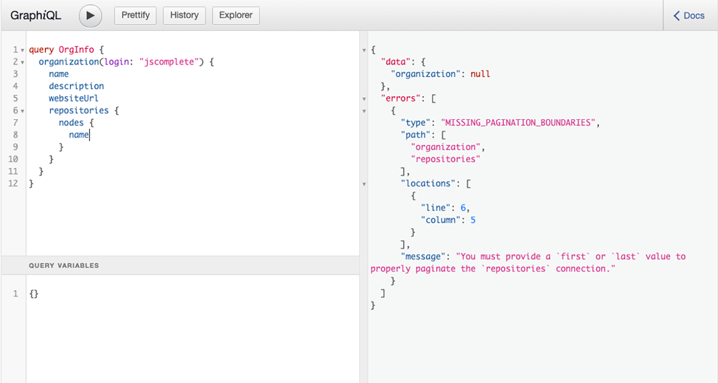
“fenago”,
Limiting the number of records returned
Notes:
When you ask for a list of records from a collection, a good API will always ask you to provide a limit. How many records are you interested in?
It is usually a bad idea to leave a general API capability for listing records in a collection without a limit. You do not want a client to be able to fetch more than a few hundred records at a time, because that would put your API server at risk of resource exhaustion and does not scale well. This is exactly why the GitHub API requires the use of an argument like first (or last) when you ask it for a list of records. Go ahead and try to ask for all the repositories under the fenago organization. You can use the repositories field within the organization field in the OrgInfo query in listing 3.3. You should see that GitHub asks for a first or last value, as shown in figure

Slide 9
Limiting the number of records returned
query First10Repos {
organization(login: "fenago") {
name
description
websiteUrl
repositories(first: 10) {
nodes {
name
}
}
}
}
Notes:
Since any list of records in a database has a certain order, you can limit your request results using either end of that order. If you are interested in 10 records, you can get the first 10 records or the last 10 records using these arguments.
Here is the query you can use to retrieve the first 10 repositories under the fenago organization.
By default, the GitHub API orders the repositories in ascending order by date of creation. You can customize that ordering logic with another field argument.

Slide 10
Ordering records returned by a list field
query orgReposByName {
organization(login: "fenago") {
repositories(first: 10, orderBy: { field: NAME, direction: ASC }) {
nodes {
name
}
}
}
}
Notes:
In the previous example, the GitHub API ordered the list of repositories under the fenago organization by the CREATED_AT repository field, which is the default order field. The API supports many other order fields, including UPDATED_AT, PUSHED_AT, NAME, and STARGAZERS.
Here is a query to retrieve the first 10 repositories when they are ordered alphabetically by name.

Slide 11
Ordering records returned by a list field
query OrgPopularRepos {
organization(login: "fenago") {
repositories(first: 10, orderBy: { field: STARGAZERS, direction: DESC }) {
nodes {
name
}
}
}
}
Notes:
Can you use the GitHub field arguments you learned about to find the top-10 most popular repositories under the fenago organization? Base a repository’s popularity on the number of stars it has.
Here is one query you can use to do that.

Slide 12
Paginating through a list of records
query OrgRepoConnectionExample {
organization(login: "fenago") {
repositories(first: 10, orderBy: { field: CREATED_AT, direction: ASC }) {
edges {
cursor
node {
name
}
}
}
}
}
Notes:
When you need to retrieve a page of records, in addition to specifying a limit, you need to specify an offset. In the GitHub API, you can use the field arguments after and before to offset the results returned by the arguments first and last, respectively.
To use these arguments, you need to work with node identifiers, which are different than database record identifiers. The pagination interface that the GitHub API uses is called the Connection interface (which originated from the Relay framework as well). In that interface, every record is identified by a node field (similar to the Node interface) using a cursor field. The cursor is basically the ID field for each node, and it is the field we use with the before and after arguments.
To work with every node’s cursor next to that node’s data, the Connection interface adds a new parent to the node concept called an edge. The edges field represents a list of paginated records.
Here is a query that includes cursor values through the edges field.
Note that within an edges field, we now ask about a single node field because the list is no longer a list of nodes but rather a list of edges where each edge is a node plus a cursor.

Slide 13
query OrgRepoConnectionExample2 {
organization(login: "fenago") {
repositories(
first: 10,
after: "Y3Vyc29yOnYyOpK5MjAxNy0wMS0yMVQwODo1NTo0My0wODowMM4Ev4A3",
orderBy: { field: CREATED_AT, direction: ASC }
) {
edges {
cursor
node {
name
}
}
}
}
}
Notes:
Now that you can see the string values of these cursors, you can use them as the after and before arguments to fetch extra pages of data. For example, to fetch the second page of the repositories under the fenago organization, you need to identify the cursor of the last repository on the first page and use that cursor value as the after value.
The introduction of the edges field also allows the addition of metadata about the list. For example, on the same level where we ask for a list of edges, we can also ask how many records in total this relation has and whether there are more records to fetch after the current page.

Slide 14
query OrgReposMetaInfoExample {
organization(login: "fenago") {
repositories(
first: 10,
after: "Y3Vyc29yOnYyOpK5MjAxNy0wMS0yMVQwODo1NTo0My0wODowMM4Ev4A3",
orderBy: { field: STARGAZERS, direction: DESC }
) {
totalCount
pageInfo {
hasNextPage
}
edges {
cursor
node {
name
}
}
}
}
}
Notes:
the previous query modified to show some metadata about the relation.
Since the fenago organization has more than 20 repositories (two pages, in this example), the hasNextPage field is true. When you fetch the very last page, hasNextPage will return false, indicating that there is no more data to fetch. This is much better than having to do an extra empty page fetch to conclude that you have reached the end of the paginated data.

Slide 15
Searching and filtering
query SearchExample {
repository(owner: "twbs", name: "bootstrap") {
projects(search: "v4.1", first: 10) {
nodes {
name
}
}
}
}
Notes:
A field argument in GraphQL can be used to provide filtering criteria or search terms to limit the results returned by a list. Let’s see examples for both features.
In GitHub, a repository can have a list of projects to manage any work related to that repository. For example, the Twitter Bootstrap repository at GitHub uses a project per release to manage all the issues related to a single release. Here is a query that uses a search term within the projects relation to return the Twitter Bootstrap projects that start with v4.1.

Slide 16
Searching and filtering
query FilterExample {
viewer {
repositories(first: 10, affiliations: OWNER) {
totalCount
nodes {
name
}
}
}
}
Notes:
Note that the projects field also implements the Connection interface.
Some fields allow you to filter the returned list by certain properties of that field. For example, by default, the list of your repositories under the viewer field includes all the repositories that you own or can contribute to. To list only the repositories that you own, you can use the affiliations field argument.

Slide 17
Providing input for mutations
mutation StarARepo {
addStar(input: { starrableId: "MDEwOlJlcG9zaXRvcnkxMjU2ODEwMDY=" }) {
starrable {
stargazers {
totalCount
}
}
}
}
Notes:
The field arguments concept is what GraphQL mutations use to accept the mutation operation’s input. In the previous lesson, we used the following mutation example to add a star to the graphql repository under the fenago organization.
The input value in that mutation is also a field argument. It is a required argument. You cannot perform a GitHub mutation operation without an input object. All GitHub API mutations use this single required input field argument that represents an object. To perform a mutation, you pass the various input values as key/value pairs on that input object.
NOTE
Not all arguments are required. A GraphQL API can control which arguments are required and which are optional.
There are many more cases where a field argument can be useful. Explore the GitHub API and other publicly available GraphQL APIs for more useful patterns for field arguments.

Slide 18
Customizing fields with arguments returned by a list field
Renaming fields with aliases
Customizing responses with directives
GraphQL fragments
Table of Contents

Slide 19
Renaming fields with aliases
Let’s say you are developing the profile page in GitHub.
Here is a query to retrieve partial profile information for a GitHub user.
query ProfileInfo {
user(login: "samerbuna") {
name
company
bio
}
}
Notes:
The alias feature in a GraphQL operation is very simple but powerful because it allows you to customize a response coming from the server through the request itself. By using aliases, you can minimize any post-response processing on the data.

Slide 20
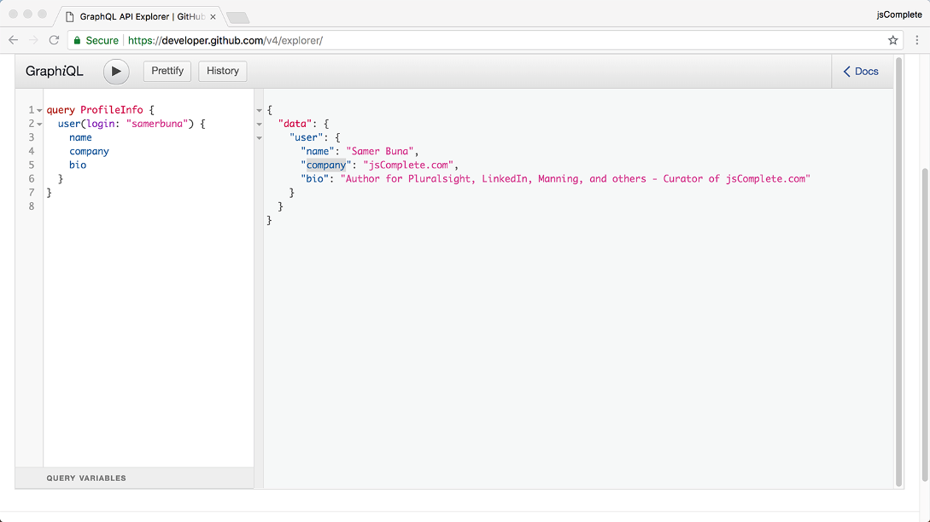
Searching and filtering
“fenago”,
Notes:
You get a simple user object in the response
Now an application UI can use this user object in the query’s response to substitute for the values in a UI template. However, suppose you have just discovered a mismatch between the structure of your response and the structure the application UI is using for the user object. The application UI was developed to expect a companyName field on a user instead of a company field (as found in the API response). What do you do? Assume that changing the application UI code itself is not an option.
If you do not have the option to use an alias (I will show you how in a bit), you can process the response every time you need to use the response object. You’ll have to transform the user object from the response into a new object with the right structure. This can be costly if the structure you are working with is deep and has multiple levels.
Luckily, in GraphQL, the awesome alias feature lets us declaratively instruct the API server to return fields using different names. All you need to do is specify an alias for that field, which you can do using this syntax:
aliasName: fieldName

Slide 21
Searching and filtering
query ProfileInfoWithAlias {
user(login: "samerbuna") {
name
companyName: company
bio
}
}
Notes:
Just prefix any field name with an alias, and the server will return that field renamed using your alias. There is no need to process the response object. For the example in listing 3.13, all you need to do is specify a companyName alias.
This gives a response that is ready for you to plug into the application UI see next slide

Slide 22
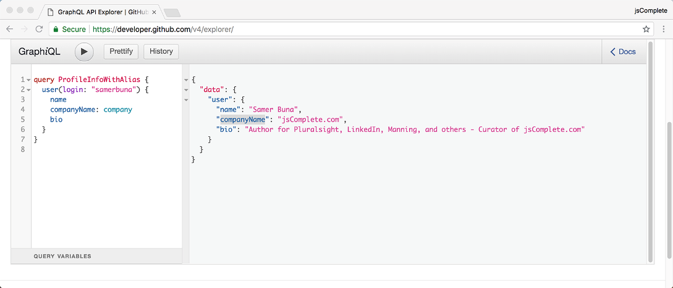
Searching and filtering

Slide 23
Customizing fields with arguments returned by a list field
Renaming fields with aliases
Customizing responses with directives
GraphQL fragments
Table of Contents

Slide 24
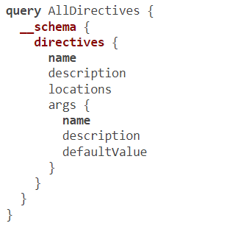
Customizing responses with directives
Notes:
Sometimes, the customization you need on a server response goes beyond the simple renaming of fields. You may need to conditionally include (or exclude) branches of data in your responses. This is where the directives feature of GraphQL can be helpful.
A directive in a GraphQL request is a way to provide a GraphQL server with additional information about the execution and type validation behavior of a GraphQL document. It is essentially a more powerful version of field arguments: you can use directives to conditionally include or exclude an entire field. In addition to fields, directives can be used with fragments and top-level operations.
A directive is any string in a GraphQL document that begins with the @ character. Every GraphQL schema has three built-in directives: @include, @skip, and @deprecated. Some schemas have more directives. You can use this introspective query to see the list of directives supported by a schema.
This query shows the name and description of each directive and includes an array of all possible locations where that directive can be used

Slide 25
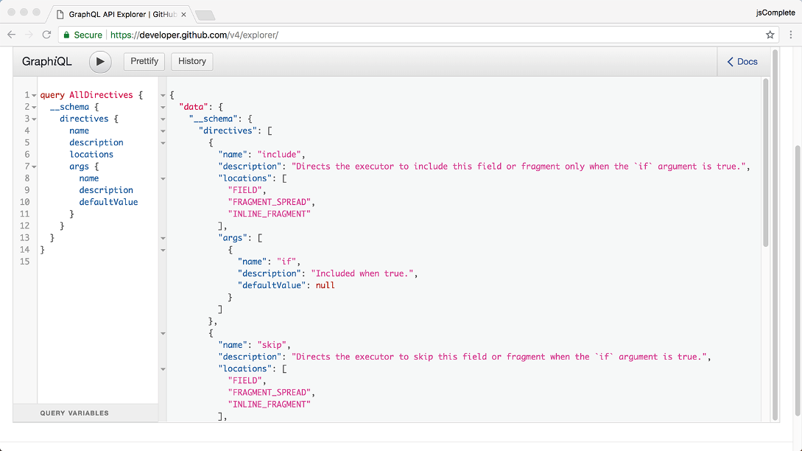
Notes:
In addition, it lists all arguments supported by that directive. Each directive can optionally receive a list of arguments, and just like field arguments, some argument values may be required by the API server. The response to the previous query should show that in any GraphQL schema, both the @include and @skip directives have the argument if. The @deprecated directive has the argument reason.
The list of locations in the previous query’s response is also important. Directives can be used only in the locations they are declared to belong to. For example, the @include and @skip directives can only be used after fields or fragments. You cannot use them at the top level of an operation. Similarly, the @deprecated directive can only be used after field definitions or ENUM values when defining a GraphQL service schema.
NOTE
An ENUM (enumerated) type represents a set of possible unique values. We’ll see an example in the next lesson.
Since directives are usually used with arguments, they are often paired with query variables to have them sent with a dynamic value. We saw some examples of variables in the previous lesson, but let me remind you about them.

Slide 26
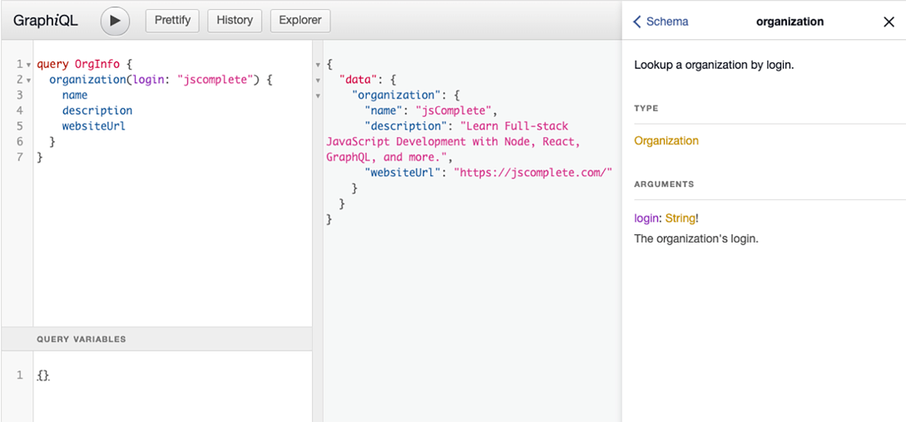
“fenago”,
“fenago”,
Variables and input values
Notes:
A variable is simply any name in the GraphQL document that begins with a $ sign: for example, $login or $showRepositories. The name after the $ sign can be anything. We use variables to make GraphQL operations generically reusable and avoid having to hardcode values and concatenate strings.
To use a variable in a GraphQL operation, you first need to define its type. You do that by providing arguments to any named operation. For example, let’s take the query example that we used to read information about the fenago organization at GitHub. Instead of hardcoding the login value (as we did before), let’s now use a variable. The operation must have a name, and then we can use that name’s arguments to define any variables. Let’s call the variable $orgLogin. It should be a required string. You can see the type of the arguments using the Docs explorer. Look up the organization field to see the type of its login argument. You can also click the organization field in the query while holding the Command key (Ctrl in Windows).
As you can see in figure, the login argument has a type of String!. The trailing exclamation mark on that type is GraphQL’s way of labeling the argument value as required. A value for this login argument must be specified-it cannot be null.

Slide 27
Variables and input values
query OrgInfo($orgLogin: String!) {
organization(login: $orgLogin) {
name
description
websiteUrl
}
}
Notes:
Now we can use the same syntax to define the new variable. The type for $orgLogin should match the type of the argument where it is going to be used. Here is the OrgInfo query written with this new $orgLogin variable.

Slide 28
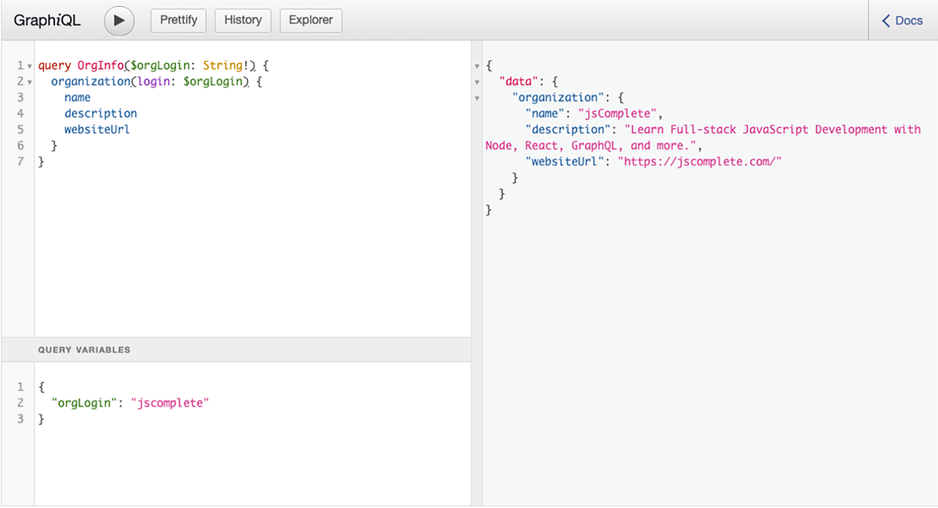
“fenago”,
Notes:
Note that on the first line, the query specifies that $orgLogin is a String!.
You cannot execute the query in listing 3.16 as is. If you try, the GraphQL server will return an error. Since we used a variable, we must give the executor on the server the value that we wish to use for that variable. In GraphiQL, we do that using the variables editor, which is in the lower-left corner. In that editor, you write a JSON object that represents all variables you want to send to the executor along with the operation.
Since we used only one variable, the JSON object for that is
{
"orgLogin": "fenago"
}
Now you can execute the query with different JSON objects, making it reusable for different organizations

Slide 29
Variables and input values
query OrgInfoWithDefault($orgLogin: String = "fenago") {
organization(login: $orgLogin) {
name
description
websiteUrl
}
}
Notes:
A variable like $orgLogin can also have a default value, in which case it does not need the trailing exclamation mark. You specify the default value using an equals sign after the type of the variable. For example, the previous query can have the value "fenago" as the default value of $orgLogin using this syntax.
You can execute this OrgInfoWithDefault query without passing a JSON object for variables. The query will use the default value in that case. If you pass a JSON object with a value for orgLogin, that value will override the default value.
Variables can be used in fields and directives to make them accept input values of various literal primitives. An input value can be scalar, like Int, Float, String, Boolean, or Null. It can also be an ENUM value, a list, or an object. The $orgLogin variable represents a scalar string input value for the login argument within the organization field. Read the various GraphQL operation examples we have seen so far and try to identify more input values. For example, try to find where we used an object as an input value.
Now that we know how to define and use variables and values, let’s use them with directives.

Slide 30
The @include directive
The @include directive can be used after fields (or fragments) to provide a condition (using its if argument).
That condition controls whether the field (or fragment) should be included in the response.
The use of the @include directive looks like this:
fieldName @include(if: $someTest)
Notes:
This says to include the field when the query is executed with $someTest set to true and not to include the field when $someTest is set to false. Let’s look at an example from the GitHub API.
Building on the previous OrgInfo query example, let’s assume that we want to conditionally include an organization’s websiteUrl based on whether we are showing full or partial details in the UI. Let’s design a Boolean variable to represent this flag and call it $fullDetails.
This new $fullDetails variable will be required because we are about to use it with a directive.

Slide 31
The @include directive
The first line of the OrgInfo query needs to be changed to add the type of $fullDetails:
query OrgInfo($orgLogin: String!, $fullDetails: Boolean!) {
Notes:
Now we want to include the websiteUrl only when we execute the OrgInfo query with $fullDetails set to true. A simple use of the @include directive can do that.

Slide 32
The @include directive
The if argument value in this case will be the $fullDetails variable. Here is the full query.
query OrgInfo($orgLogin: String!, $fullDetails: Boolean!) {
organization(login: $orgLogin) {
name
description
websiteUrl @include(if: $fullDetails)
}
}

Slide 33
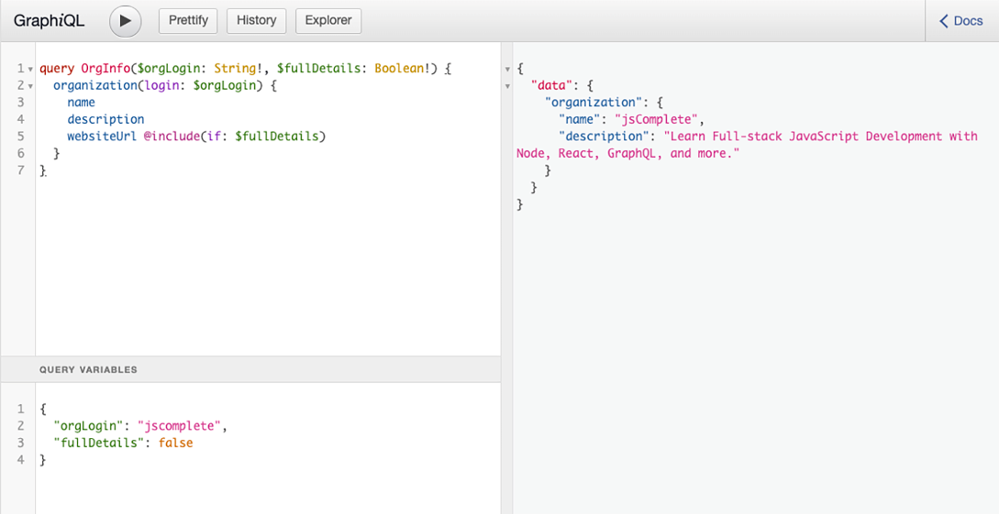
“fenago”,
“fenago”,
Notes:
Go ahead and test this query by executing it with $fullDetails set to true and then to false. You will see that the response honors that Boolean value and uses it to include or exclude websiteUrl from the response object

Slide 34
The @skip directive
This directive is simply the inverse of the @include directive.
Just like the @include directive, it can be used after fields (or fragments) to provide a condition (using its if argument).
The condition controls whether the field (or fragment) should be excluded in the response. The use of the @skip directive looks like this:
fieldName @skip(if: $someTest)
Notes:
This means to exclude the field when the query is executed with $someTest set to true and include the field when $someTest is set to false. This directive is useful to avoid negating a variable value, especially if that variable has a negative name already.

Slide 35
The @skip directive
query OrgInfo($orgLogin: String!, $partialDetails: Boolean!) {
organization(login: $orgLogin) {
name
description
websiteUrl @skip(if: $partialDetails)
}
}
Notes:
Suppose that instead of designing the Boolean variable to be $fullDetails, we decide to name it $partialDetails. Instead of inverting that variable value in the JSON values object, we can use the @skip directive to use the $partialDetails value directly. The OrgInfo query becomes the following.
Note that a field (or fragment) can be followed by multiple directives. You can repeat @include multiple times or even use both @include and @skip together. All directive conditions must be met for the field (or fragment) to be included or excluded.

Slide 36
The @skip directive
query OrgInfo($orgLogin: String!, $partialDetails: Boolean!) {
organization(login: $orgLogin) {
name
description
websiteUrl @skip(if: $partialDetails) @include(if: false)
}
}
Notes:
Neither @include nor @skip has precedence over the other. When used together, a field is included only when the include condition is true and the skip condition is false; it is excluded when either the include condition is false or the skip condition is true. The following query will never include websiteUrl no matter what value you use for $partialDetails.

Slide 37
The @deprecated directive
The following is the GraphQL’s schema language representation of a type that has a deprecated field.
type User {
emailAddress: String
email: String @deprecated(reason: "Use 'emailAddress'.")
}
Notes:
This special directive can be used in GraphQL servers to indicate deprecated portions of a GraphQL service’s schema, such as deprecated fields on a type or deprecated ENUM values.
When deprecating a field in a GraphQL schema, the @deprecated directive supports a reason argument to provide the reason behind the deprecation.

Slide 38
Customizing fields with arguments returned by a list field
Renaming fields with aliases
Customizing responses with directives
GraphQL fragments
Table of Contents

Slide 39
GraphQL fragments
Why fragments?
To build anything complicated, the truly helpful strategy is to split what needs to be built into smaller parts and then focus on one part at a time.
Ideally, the smaller parts should be designed in a way that does not couple them with each other.
They should be testable on their own, and they should also be reusable.
Notes:
When we explored directives, I kept adding “(or fragment)” whenever I mentioned the use of a directive. It is now time to discuss my favorite feature of the GraphQL language: fragments!
A big system should be the result of putting these parts together and having them communicate with each other to form features. For example, in the UI domain, React.js (and other libraries) popularized the idea of using small components to build a full UI.
In GraphQL, fragments are the composition units of the language. They provide a way to split big GraphQL operations into smaller parts. A fragment in GraphQL is simply a reusable piece of any GraphQL operation.
I like to compare GraphQL fragments to UI components. Fragments, if you will, are the components of a GraphQL operation.
Splitting a big GraphQL document into smaller parts is the main advantage of GraphQL fragments. However, fragments can also be used to avoid duplicating a group of fields in a GraphQL operation. We will explore both benefits, but let’s first understand the syntax for defining and using fragments.

Slide 40
Defining and using fragments
For example, let’s take the simple GitHub organization information query example:
query OrgInfo {
organization(login: "fenago") {
name
description
websiteUrl
}
}
Notes:
To define a GraphQL fragment, you can use the fragment top-level keyword in any GraphQL document. You give the fragment a name and specify the type on which that fragment can be used. Then, you write a partial query to represent the fragment.

Slide 41
Defining and using fragments
To make this query use a fragment, you first need to define the fragment.
fragment orgFields on Organization {
name
description
websiteUrl
}
Notes:
This defines an orgFields fragment that can be used within a selection set that expands an organization field. The on Organization part of the definition is called the type condition of the fragment. Since a fragment is essentially a selection set, you can only define fragments on object types. You cannot define a fragment on a scalar value.

Slide 42
Defining and using fragments
To use the fragment, you “spread” its name where the fields were originally used in the query.
query OrgInfoWithFragment {
organization(login: "fenago") {
...orgFields
}
}
Notes:
The three dots before orgFields are what you use to spread that fragment. The concept of spreading a fragment is similar to the concept of spreading an object in JavaScript. The same three-dots operator can be used in JavaScript to spread an object inside another object, effectively cloning that object.
The three-dotted fragment name (...orgFields) is called a fragment spread. You can use a fragment spread anywhere you use a regular field in any GraphQL operation.
A fragment spread can only be used when the type condition of that fragment matches the type of the object under which you want to use that fragment. There are no generic fragments in GraphQL. Also, when a fragment is defined in a GraphQL document, that fragment must be used somewhere. You cannot send a GraphQL server a document that defines fragments but does not use them.

Slide 43
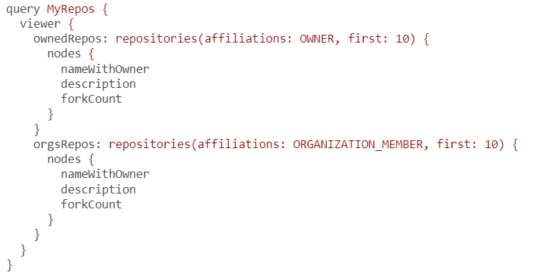
Defining and using fragments
Notes:
Fragments and DRY
Fragments can be used to reduce any duplicated text in a GraphQL document. Consider this example query from the GitHub API.
This query uses a simple alias with field arguments to have two lists with an identical structure: one list for the repositories owned by the current authenticated user and a second list of the repositories under organizations of which the current authenticated user is a member.
This is a simple query, but there is room for improvement. The fields under a repository connection are repeated. We can use a fragment to define these fields just once and then use that fragment in the two places where the nodes field is repeated. The nodes field is defined on the special RepositoryConnection in GitHub (it is the connection between a user and a list of repositories).

Slide 44
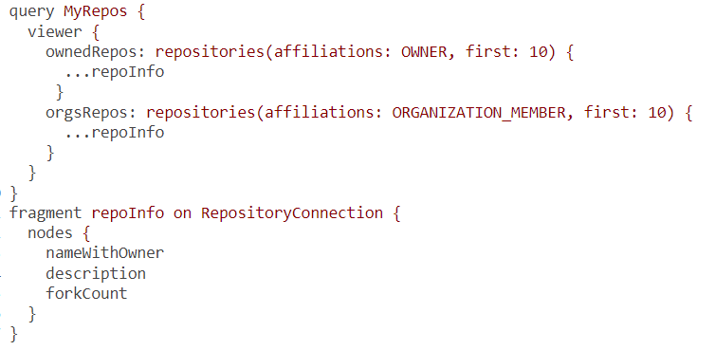
Defining and using fragments
Notes:
Here is the same GraphQL operation modified to use a fragment to remove the duplicated parts.
Pretty neat, right? But as I mentioned, the DRY benefit of fragments is less important. The big advantage of fragments is that they can be matched with other units of composition (like UI components). Let’s talk about that!

Slide 45
Summary
You can pass arguments to GraphQL fields when sending requests.
GraphQL servers can use these arguments to support features like identifying a single record, limiting the number of records returned by a list field, ordering records and paginating through them, searching and filtering, and providing input values for mutations.
Notes:
You can give any GraphQL field an alias name. This enables you to customize a server response using the client’s request text.
You can use GraphQL directives to customize the structure of a GraphQL server response based on conditions in your applications.
Directives and field arguments are often used with request variables. These variables make your GraphQL requests reusable with dynamic values without needing to resort to string concatenation.
You can use fragments, which are the composition units of GraphQL, to reuse common parts of a GraphQL query and compose a full query by putting together multiple fragments. This is a winning strategy when paired with UI components and their data needs. GraphQL also supports inline fragments that can be used to conditionally pick information out of union object types or object types that implement an interface.

Slide 46
"Complete Lab"

